Slide 1


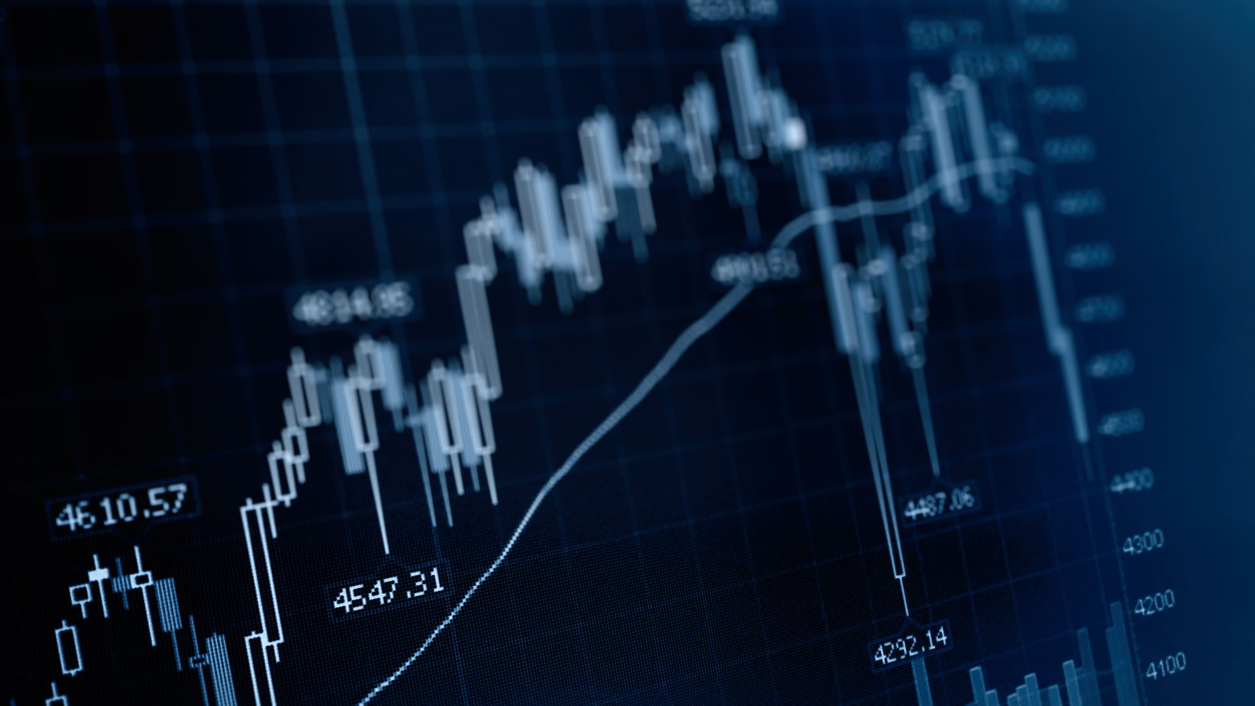
BlackRock Investment Analysis
Final Presentation
Submitted By: Group 7
Aryan Radadiya
Joyson Domnic Gonsalves
Sumit Kumar Pandey

Slide 2






Table of Content
Description
Status
Communication
Budget
Results and Findings

Slide 3



Team Members
Aryan Radadiya
Developer
Joyson Gonsalves
Team Lead
Sumit Kumar Pandey
Data Analyst

Slide 4
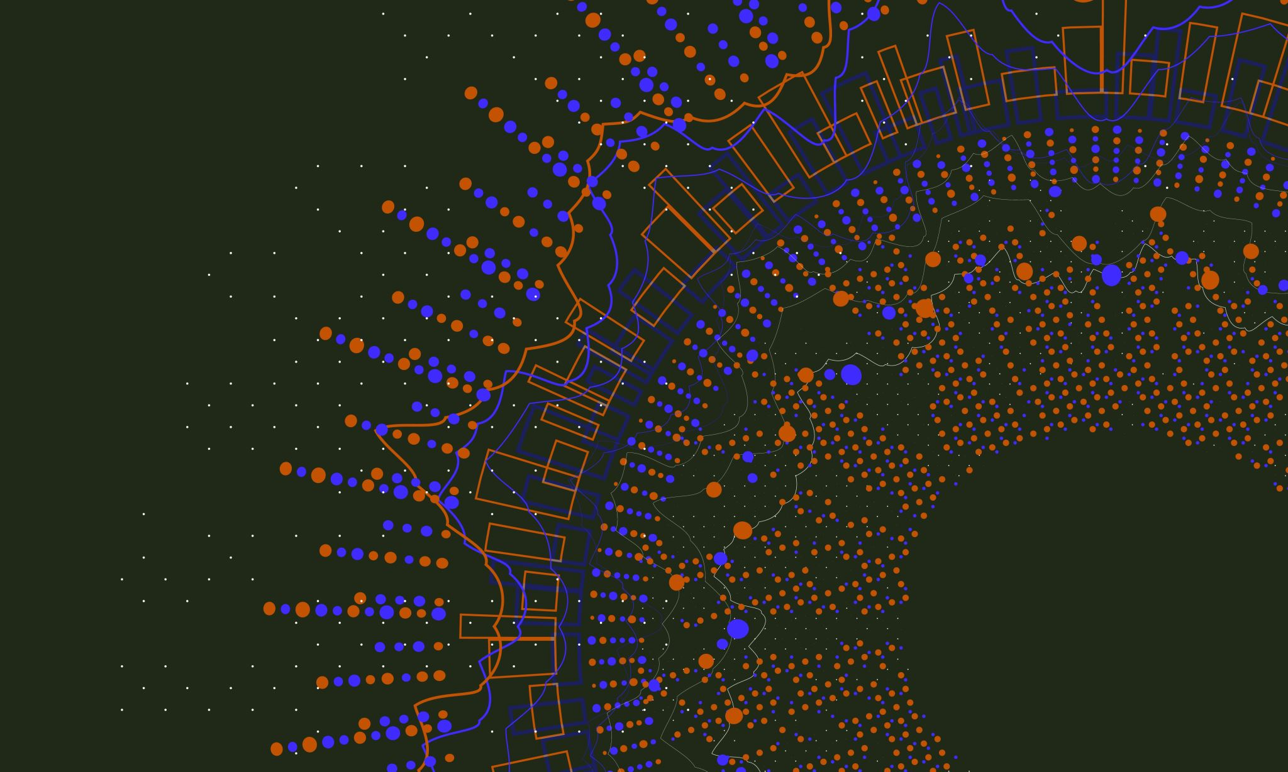
About BlackRock
Imagine BlackRock as a giant in the financial world, making big moves and decisions that impact how money flows globally. Our client, who's also a player in the financial game, wants to take a closer look at BlackRock's playbook. They're like the coach studying the strategies of a champion team. The goal? To understand exactly how BlackRock's decisions shake things up in the financial world right now. It's like looking at the game tape to see the moves that make BlackRock stand out. By doing this, our client hopes to get smart insights that can help them make better decisions in their own financial game.

Slide 5

About the project
The client aims to delve deep into BlackRock's data, seeking a comprehensive understanding of its present impact on the market. Their goal is not only to grasp the current dynamics but also to foresee the future, predicting how BlackRock's assets will evolve over time. It's essentially a quest for valuable insights that can guide strategic decision-making and prepare for the twists and turns of the financial landscape.

Slide 6
Date of Report: 8th April 2024
Date of Last Report: 19th March 2024
Prepared By: Group 7
Project Status: Finished

Slide 7

Timeline
Initial Requirement
Design
Implementation/ Coding
Development
Testing
Final Report

Slide 8


Initial Requirement

Slide 9
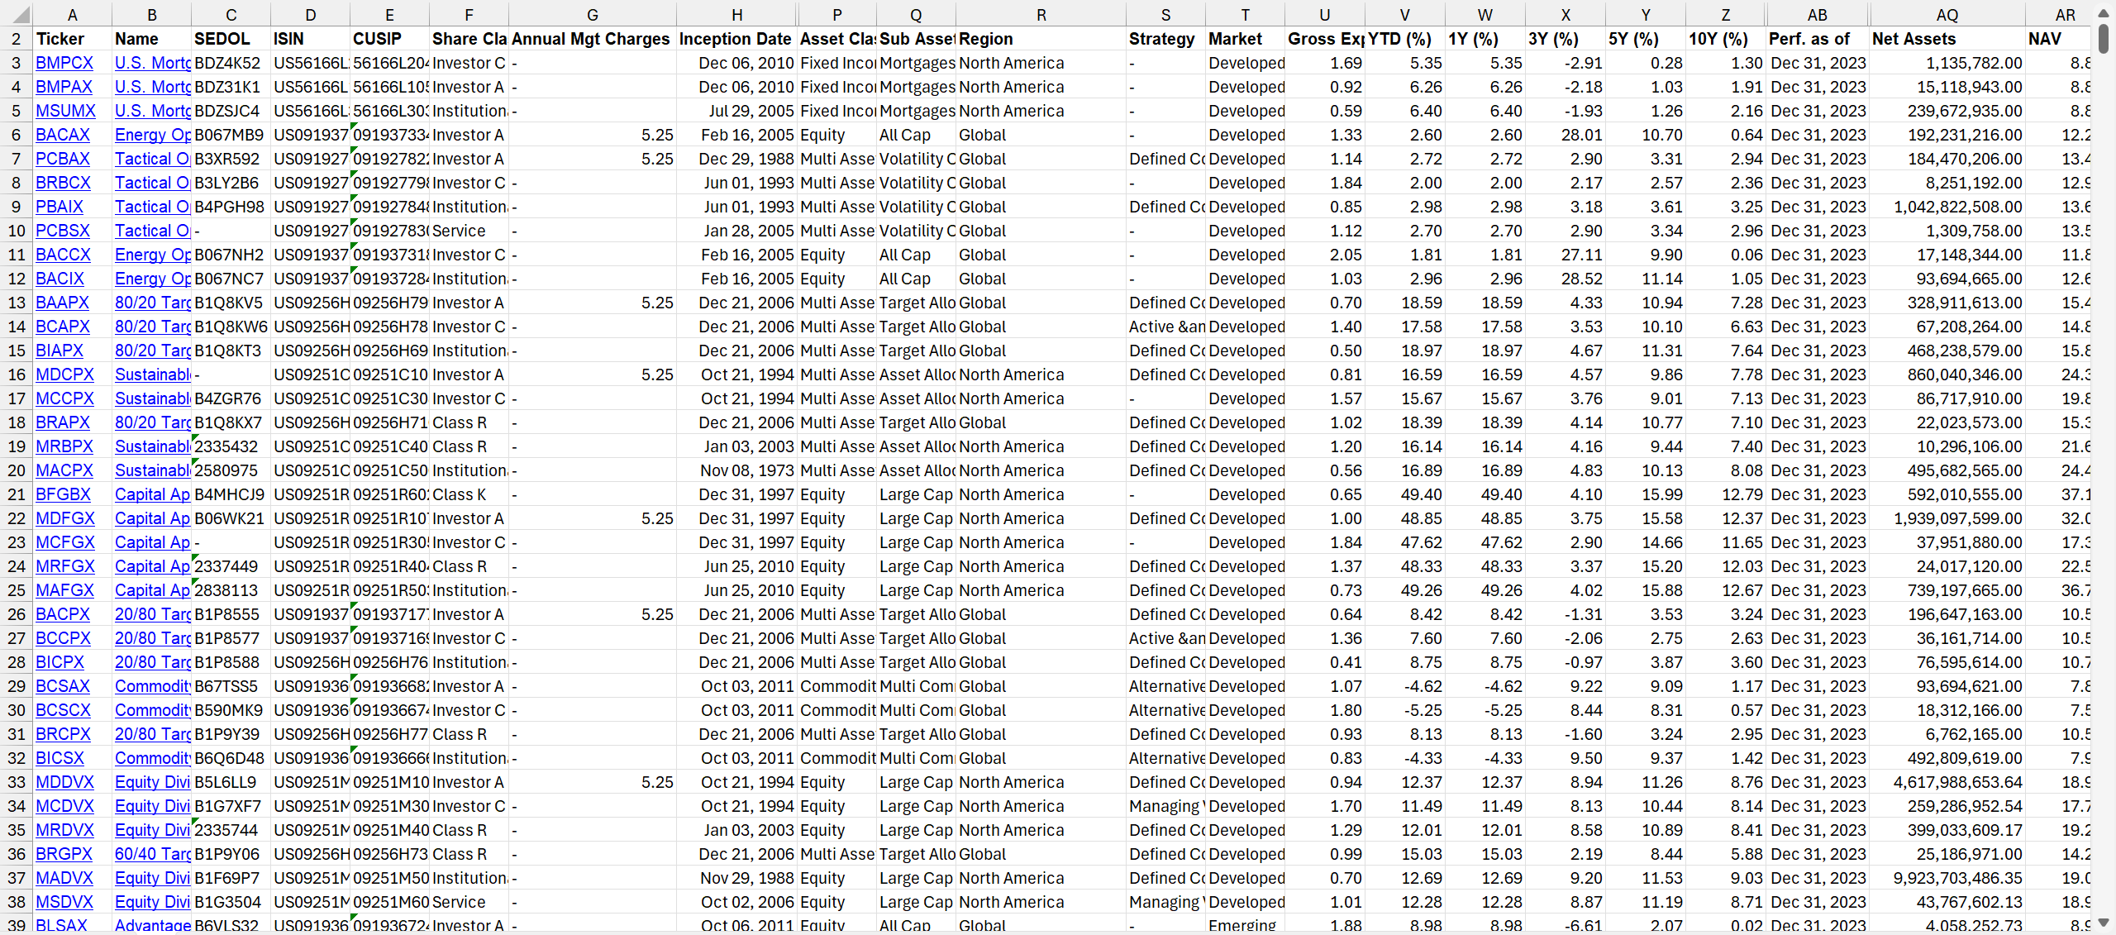
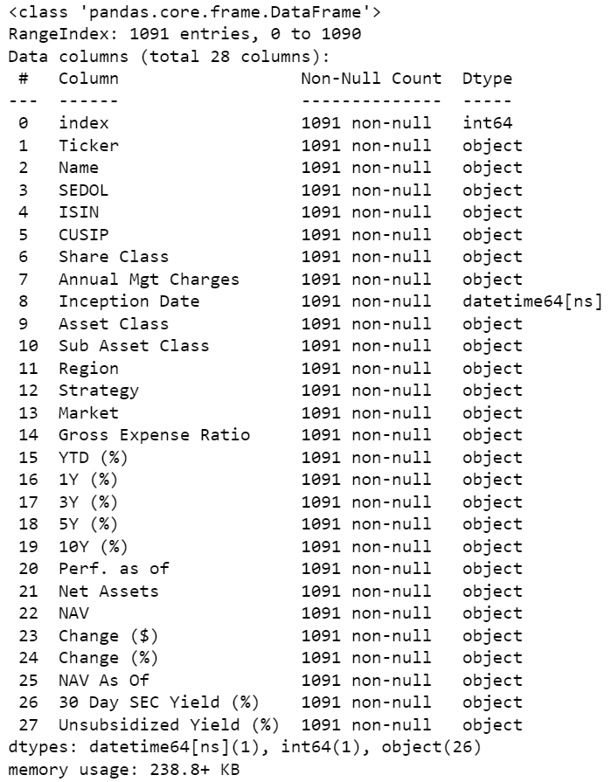
Researching Data
Source: BlackRock Investment Funds

Slide 10

Design Phase

Slide 11


Research Datasets
BlackRock has a very diverse portfolio so it is important to find right dataset which is perfect for our research.
Collecting Dataset
Initially scraping data directly from the official site is challenging so we downloaded the data to our local machine and then uploaded it to our Jupiter notebook.
Cleaning Dataset
There are many null values and unwanted data which we are not going to use so we will remove the columns and data which we don’t want.

Slide 12
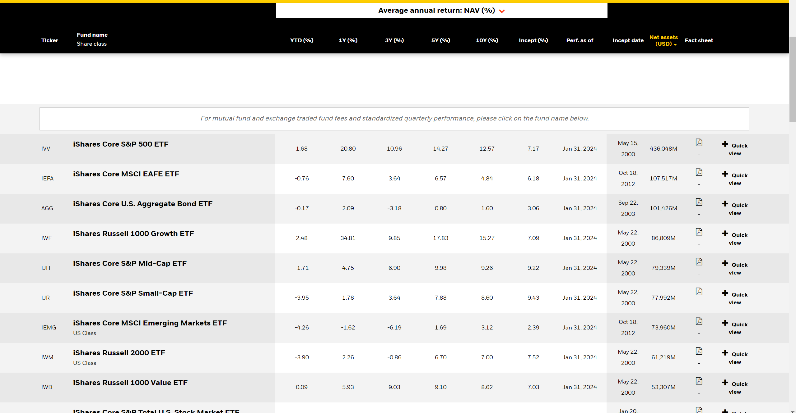
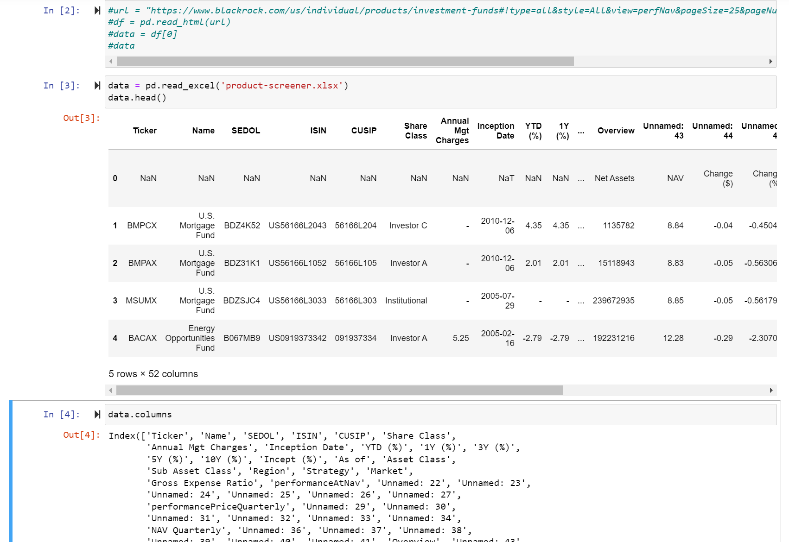
Data Collection
Importing in Jupiter Notebook
Official BlackRock Site

Slide 13
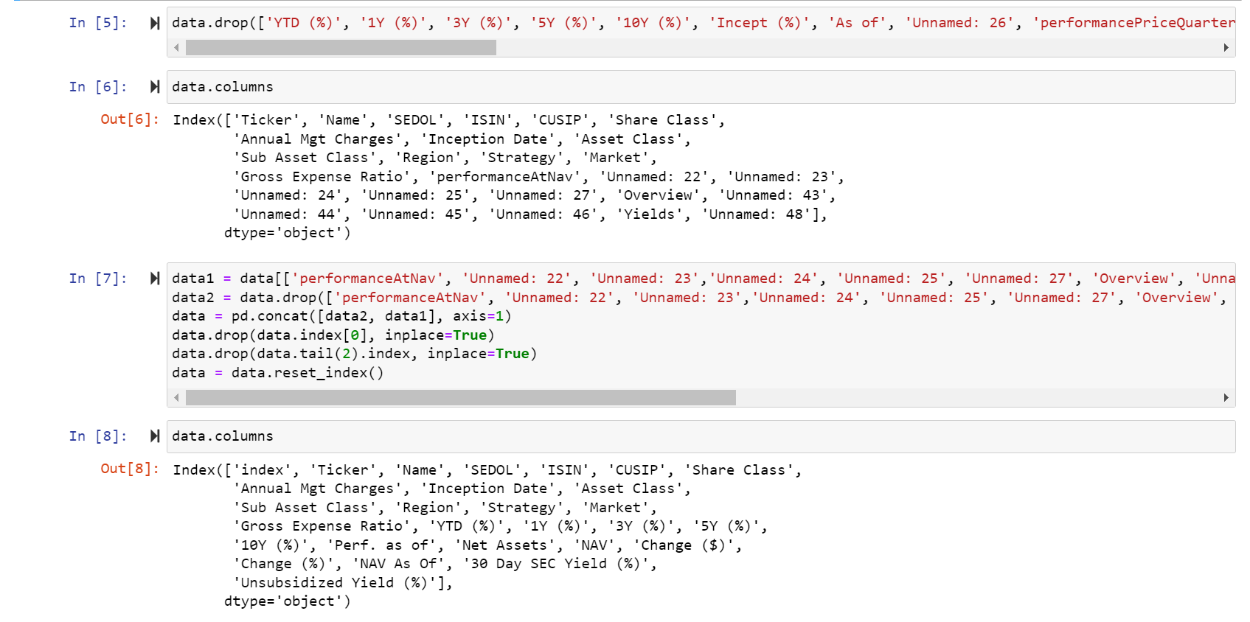
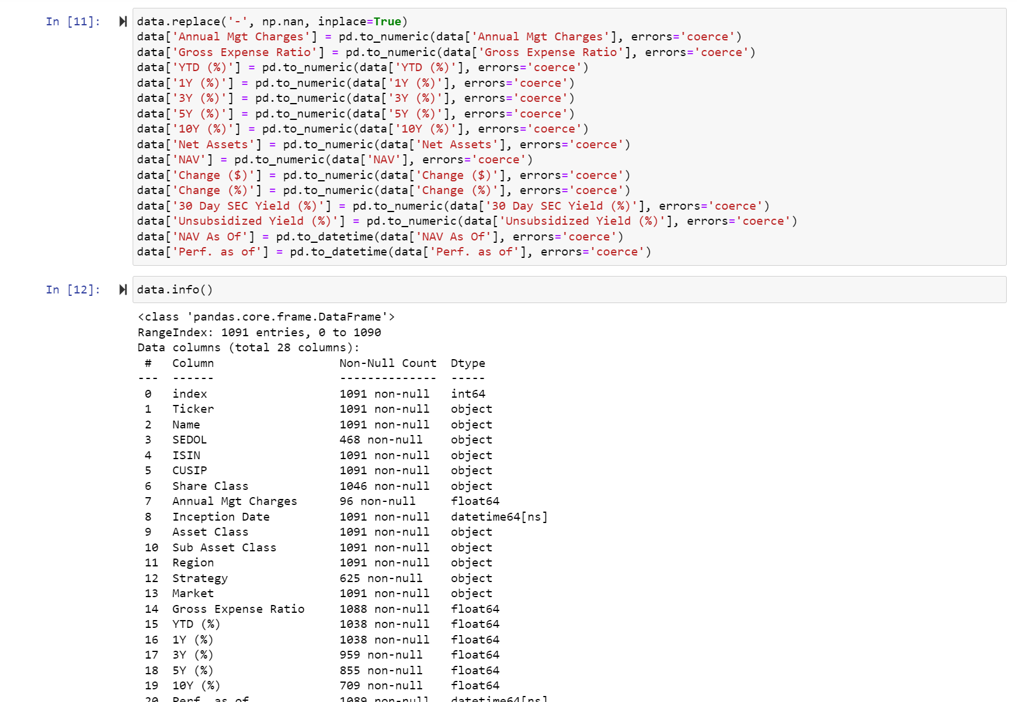
Data Cleaning
Changing data type of columns
Removing unwanted rows

Slide 14

Implementation / Coding

Slide 15
Planning the Analysis
We need to analyse the data and see which machine learning model we can apply and according to our expected outcome we need to proceed further.
Research the Analysis Model
Implement the Model
After learning about the model now we can start coding on the model and run the test cases to see if it works or not.
After completing the basic analysis we know that we can implement cluster analysis on our data. So we will research on that and gather more details.

Slide 16
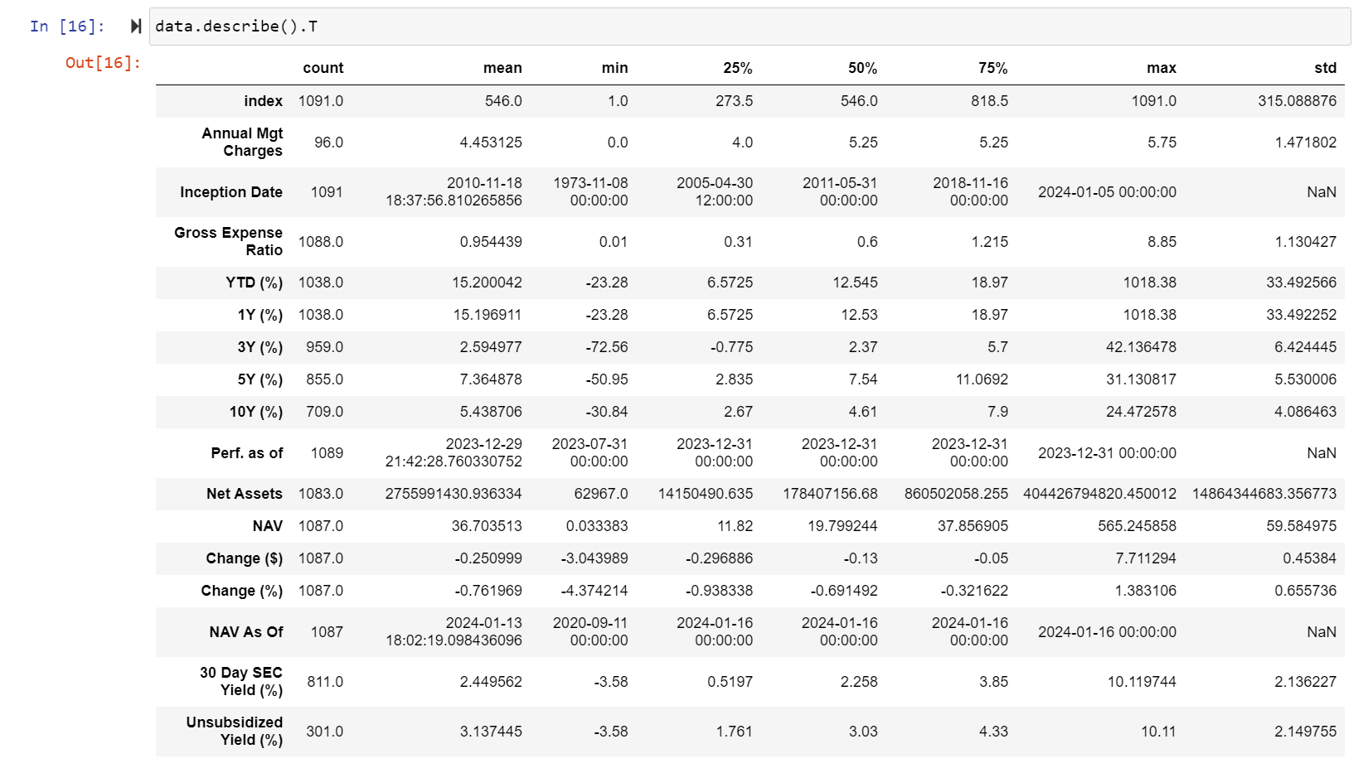
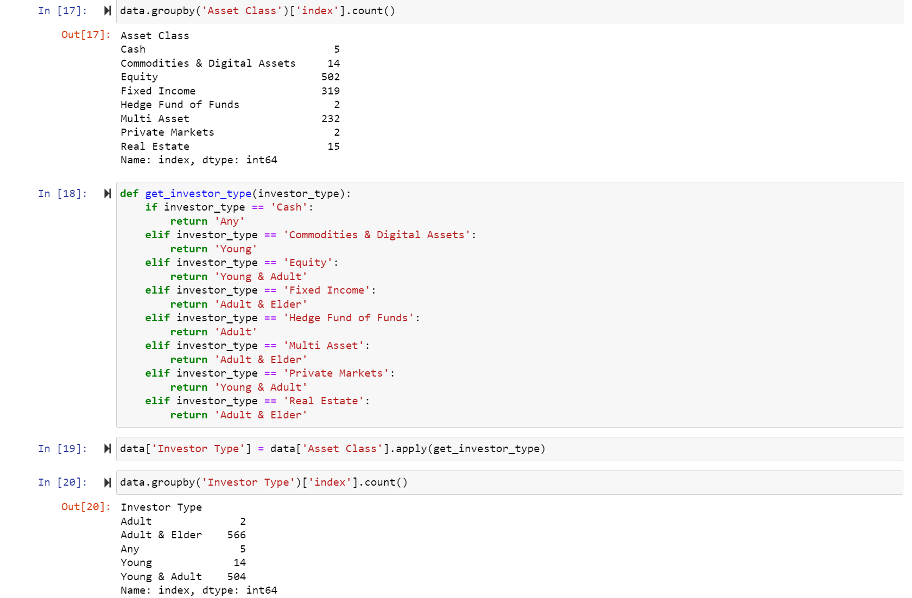
Performing the EDA Analysis
Grouping and categorising the data
Descriptive analysis on the numeric data

Slide 17
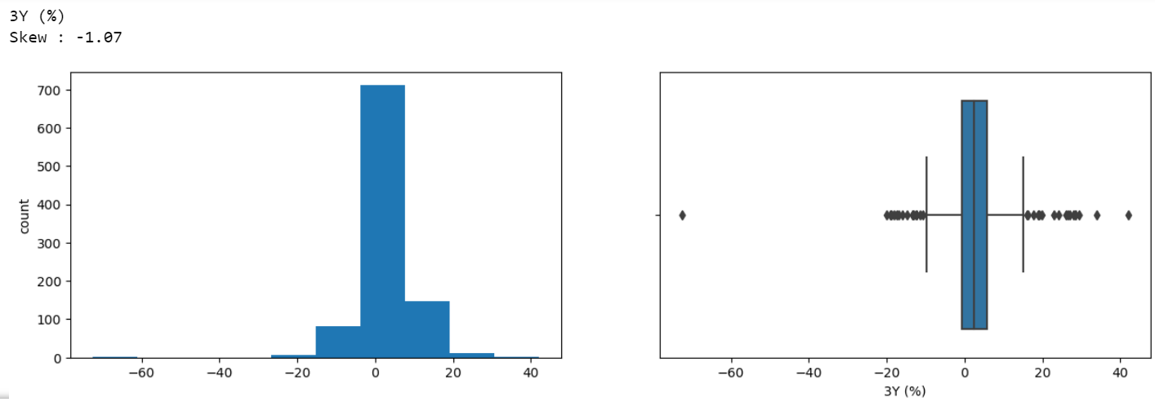
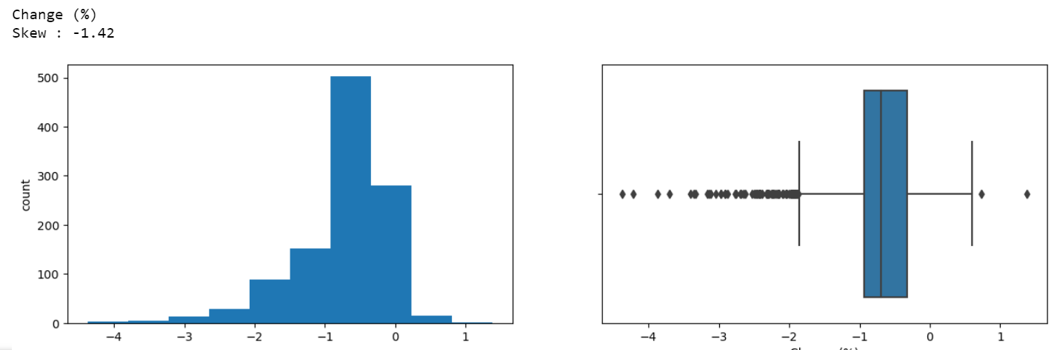
Visualizing Numeric columns

Slide 18
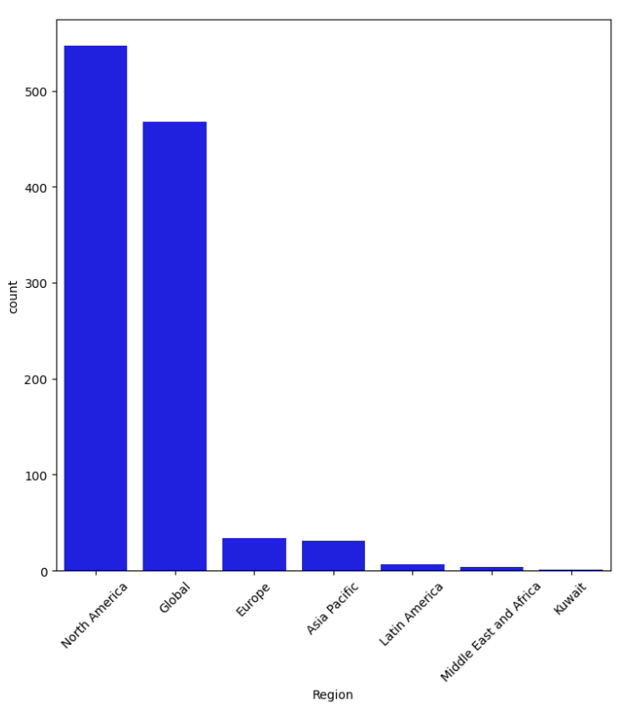
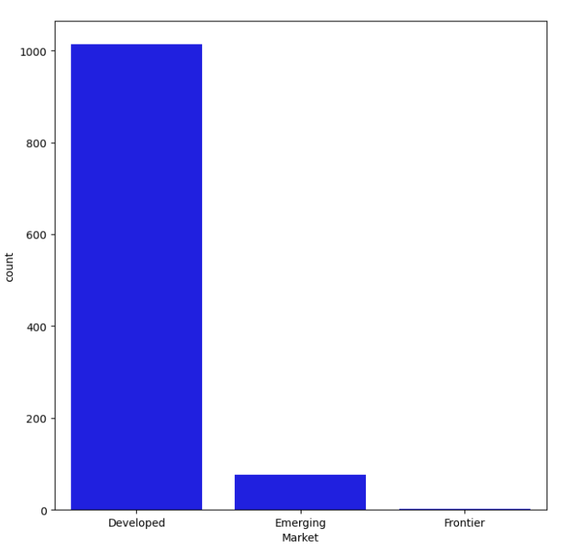
Visualizing Categorial Columns

Slide 19
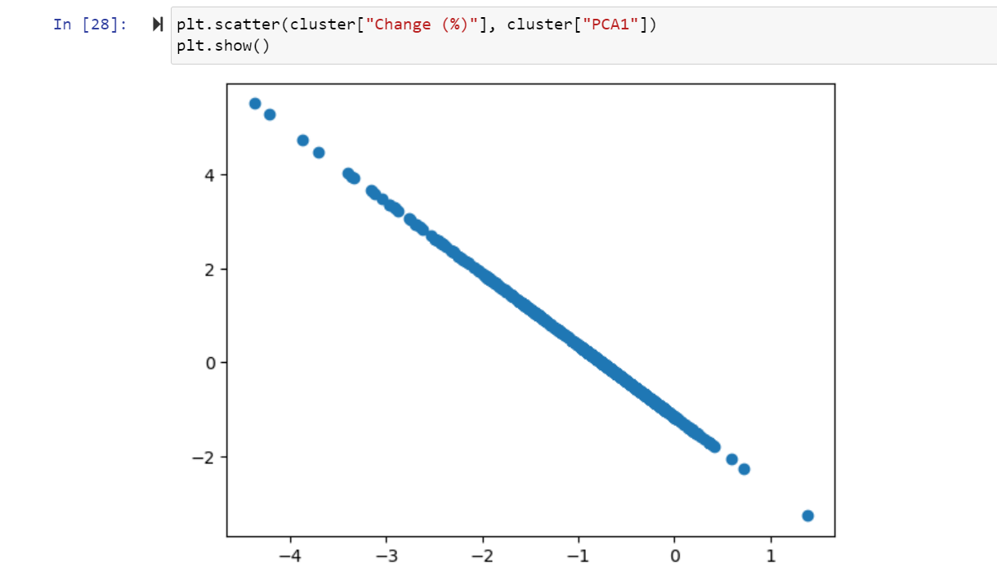
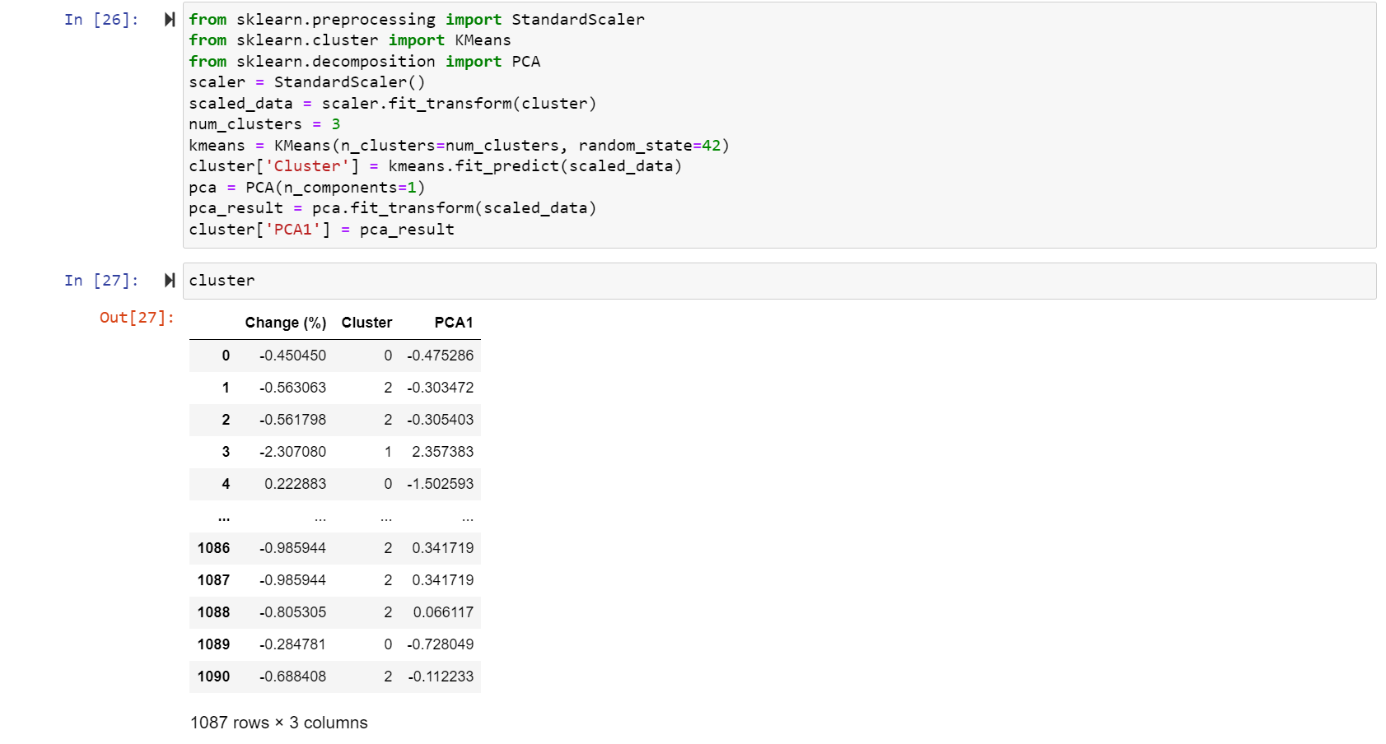
Cluster Algorithm

Slide 20

Dashboard and Story telling

Slide 21
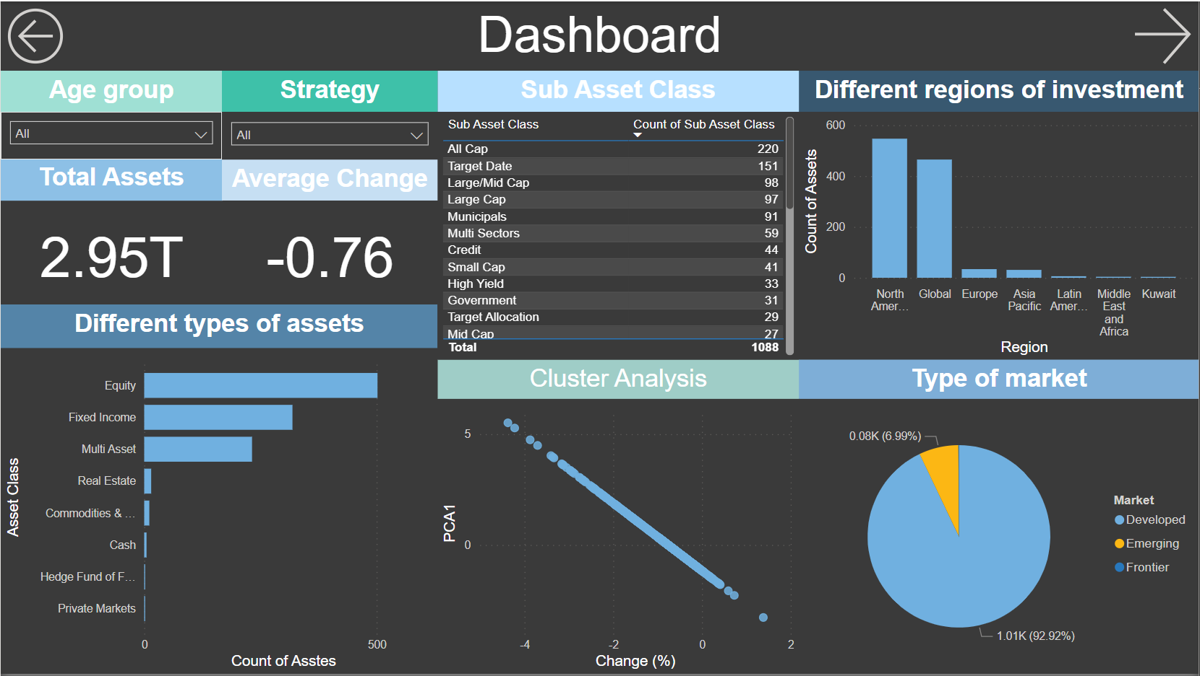
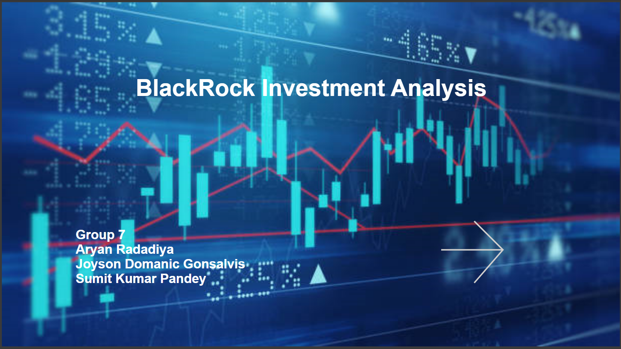
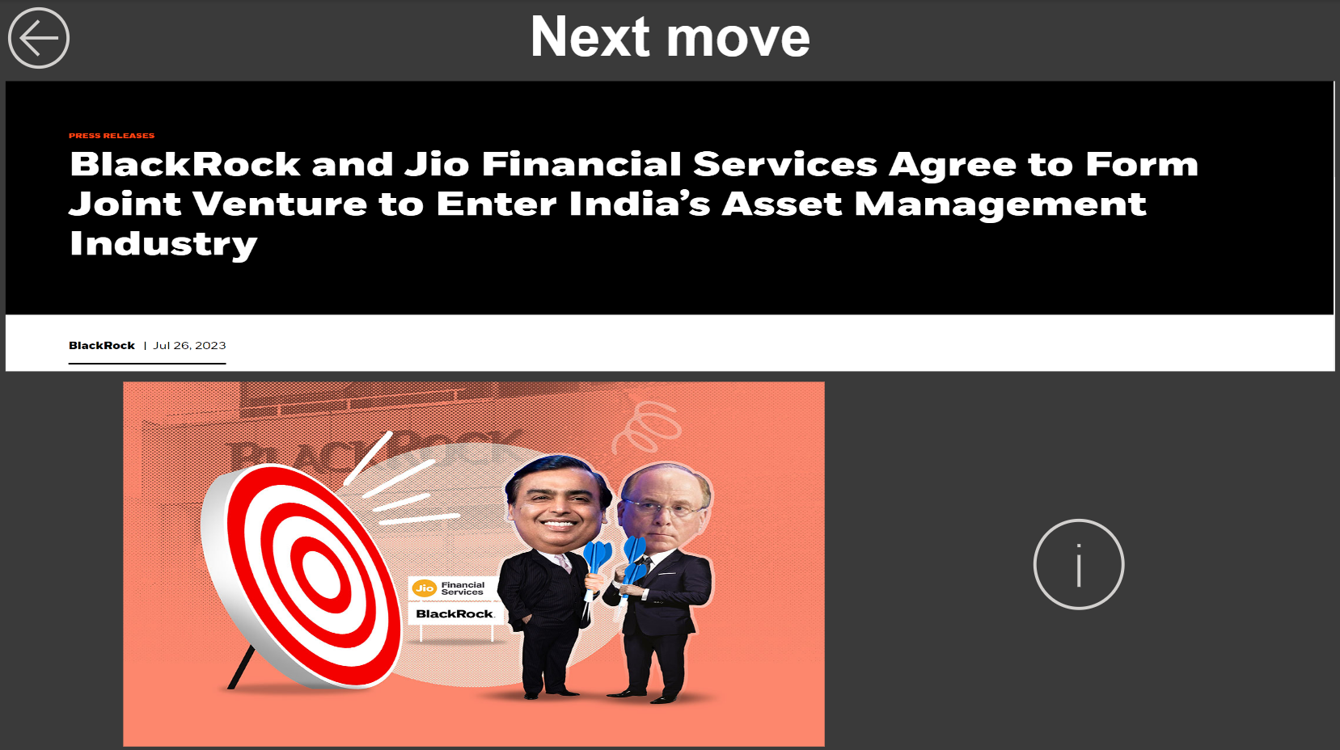

Slide 22

Communication

Slide 23
Frequency
Once a Week
Participants
Richard Lambroff
Medium
Final presentation
Agend
Aryan Radadiya
Joyson Domnic Gonsalves
Sumit Kumar Pandey
Recording
Teams Meeting
Call
Chats
Close out

Slide 24
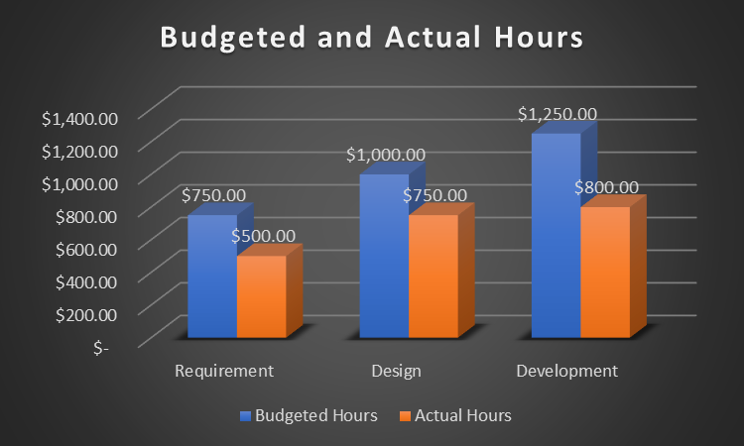
Project Cost

Slide 25

Results and findings

Slide 26

BlackRock has significant impact on the economy of many countries.
There are many investment options for all the age group according to classification.
We can monitor BlackRock’s moves and do investment accordingly.

Slide 27

Thank You Any Questions?

